Slide 1
Activity Diagram
Session 15
(Lecture)
Course : Program Design Methods
Effective Period : July 2018

Slide 2
These slides have been adapted from
Britton, C.. (2005). A student Guide to Object Oriented Development. 01. Butterworth-Heinemann. Amsterdam. ISBN: 978-0-7506-6123-2. Chapter 8
Acknowledgement

Slide 3
LO 5 : Explain the object oriented design
Learning Objectives

Slide 4
Contents
Introduction
Modeling a sequence of activities
Modeling alternatives courses of action
Modeling iteration of activities
Modeling activities that are carried out in parallel
Swimlanes

Slide 5
Introduction
In activity diagram, the states are activities and the transition between them are triggered by the completion of the activity rather than by an external event
Activity diagrams show the internal flow of control in a process.
Activity diagrams can be used to represent sequence, selection and iteration and they can also illustrate where different activities can be carried out in parallel.

Slide 6
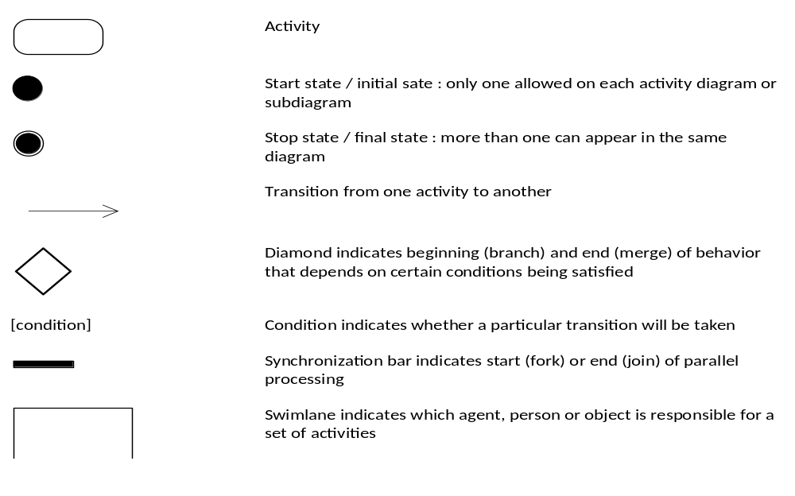
Modeling a sequence of activities

Slide 7
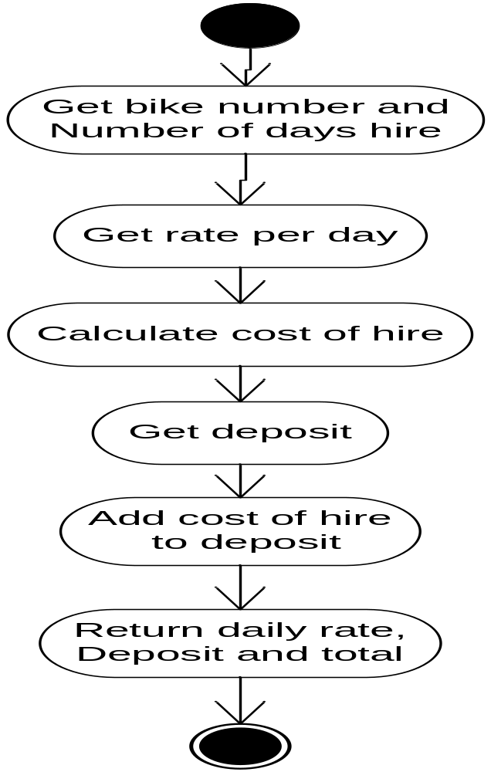
Example
Simple activity diatram for ‘getCharge()’ operation

Slide 8
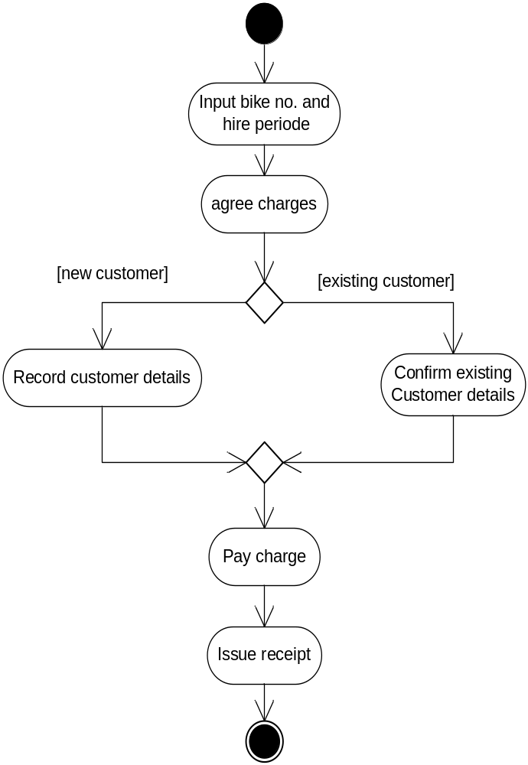
Modeling alternative courses of action
The activity diagrams can model different possible courses of action and conditions which determine which course is taken
As in state diagrams, it is essential that every guard evaluates to true or false.
Example : activity diagram for the ‘issue bike’ use case, showing alternative actions

Slide 9
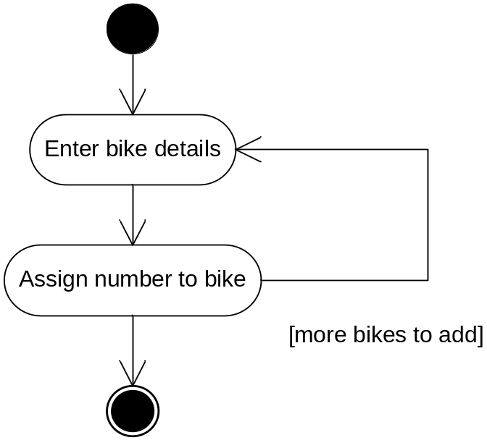
Modeling iteration of activities
Activity diagram can also model iteration where one or more activities need to be repeated

Slide 10
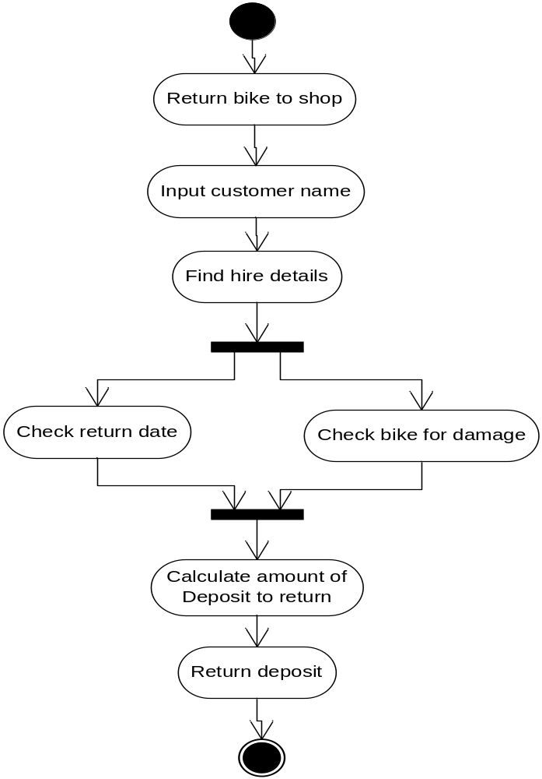
Modeling activities that are carried out in parallel
Activity diagram also illustrate activities that can be performed in parallel
Example : activity diagram for the “Handle bike return’ use case, showing parallel activities

Slide 11
Swimlanes
The information about the object that responsible can be added to this diagram by dividing diagram into vertical zones known as swimlanes
Example : modified activity diagram for the ‘Handle bike return’ use case, showing responsibilities for different activities through the addition of swimlanes

Slide 12
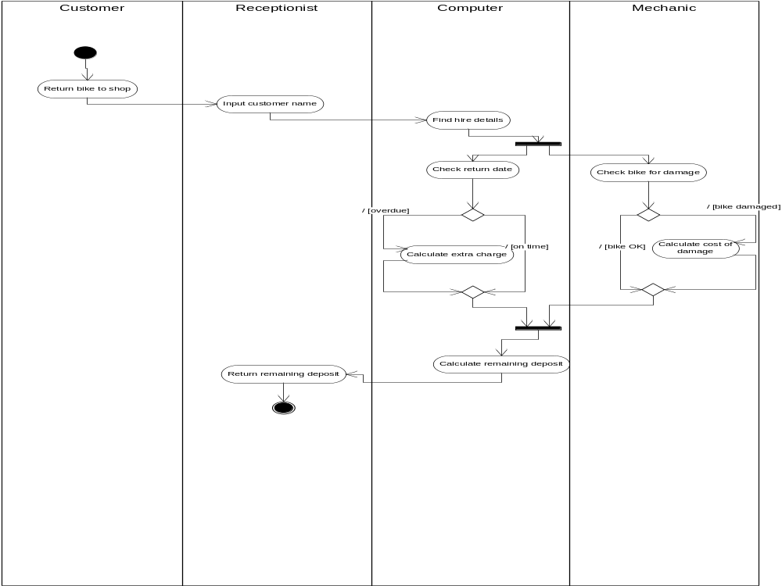

Slide 13
References
Britton, C.. (2005). A student Guide to Object Oriented Development. 01. Butterworth-Heinemann. Amsterdam. ISBN: 978-0-7506-6123-2.
Activity Diagram, http://www.agilemodeling.com/artifacts/activityDiagram.htm

Slide 14
Q & A

